Slide 1
Advanced Data Handling
Run Spring Server !!!
Dr Simon Lock
simon.lock@bristol.ac.uk

Slide 2
Aim of this session
In the previous lecture we looked at Spring & JSON
We focused primarily on interrogating JSON docs
In this lecture we look at some advanced features
“Better” ways to parse JSON
More efficient ways to package and transfer data
Remember from last time…

Slide 3
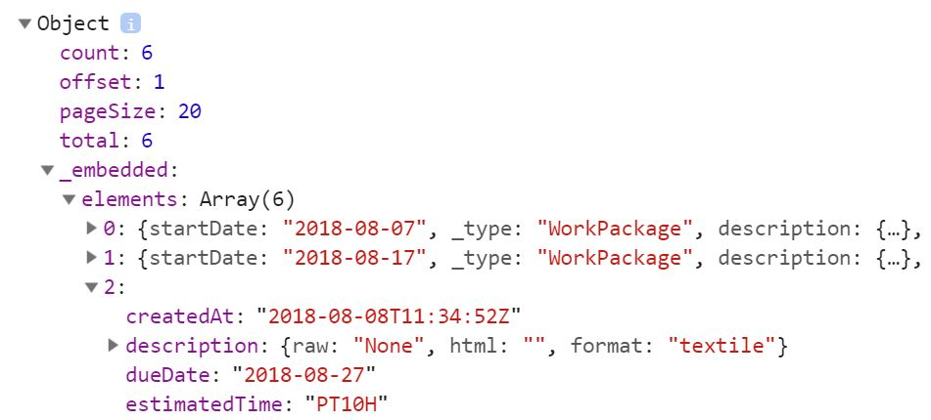
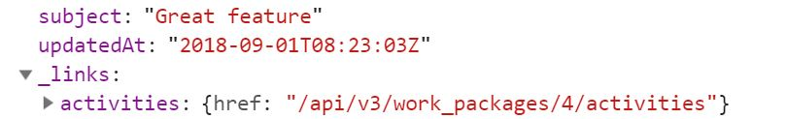

https://opserver/projects/{id}/work_packages
document
embedded
elements
2nd work package
links
type

Slide 4
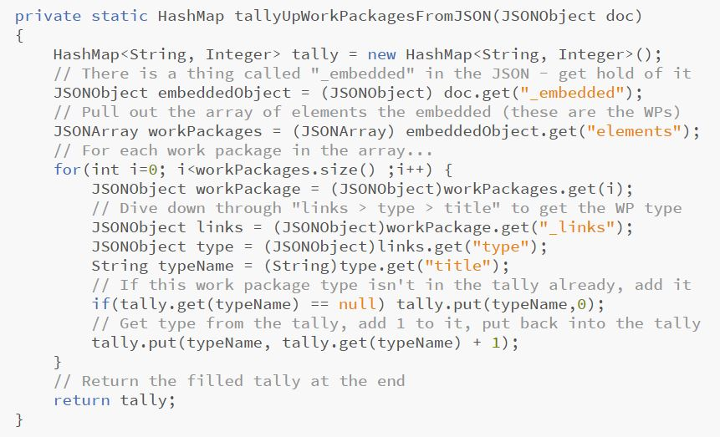
Interrogating with JSON-Simple

Slide 5
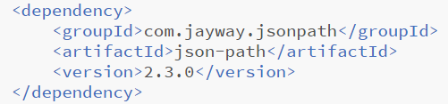
JsonPath
Pulling out all the entities with “get” is a pain
Luckily there is a faster way !
A more sophisticated parser called JsonPath
It uses a “domain specific language” for querying
Add it to your dependencies with…

Slide 6
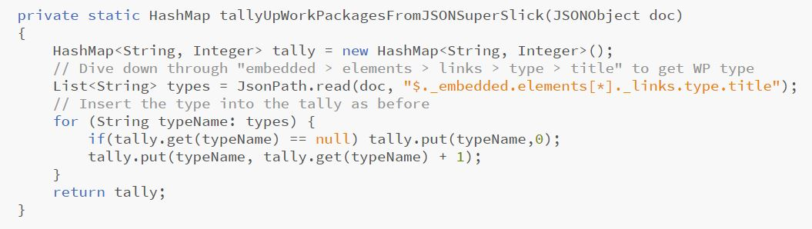
Interrogate the JSON – Improved !

Slide 7
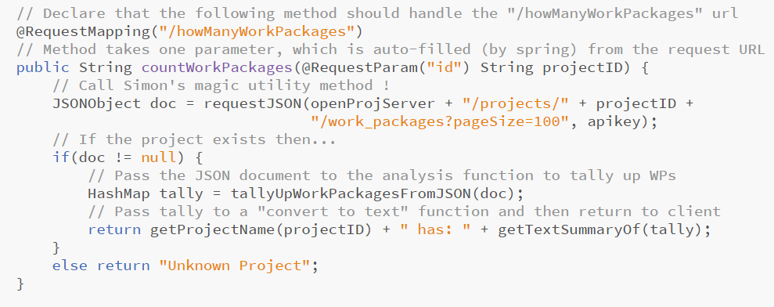
“Updated” request handler
curl http://127.0.0.1:8080/howManyWorkPackages?id=4

Slide 8
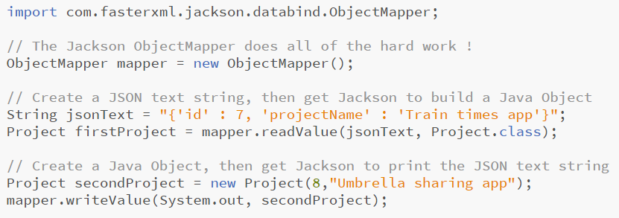
Jackson
Jackson takes JSON parsing one step further
Direct reconstruction of Java Objects from JSON
And the deconstruction of Objects into JSON text

Slide 9
Constructing JSON objects
Interpreting existing JSON docs is one thing
Sometimes we need to create JSON ourselves
Files that we can use to store data
Or JSON documents to send back to clients
Let’s update our server so it doesn’t just return text
Instead, it should send back well-formatted JSON !
Just like proper servers do (such as OpenProject)
Note: The following makes use of JSON-Simple

Slide 10
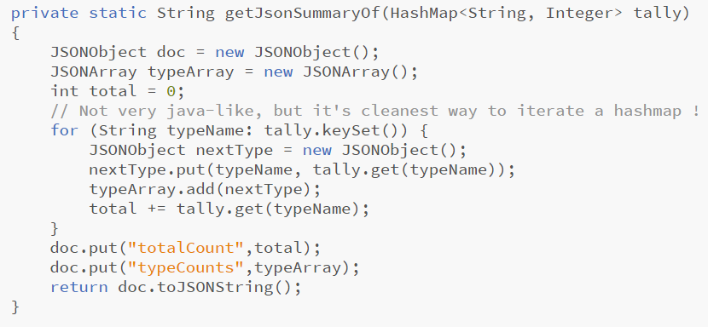
Convert Tally to JSON (with extreme animation)
Eventual JSON:
{
"totalCount“ : 4 ,
"typeCounts":
[ { "Phase“ : 2 } , { “Task“ : 2 } ]
}
DONE !!!

Slide 11
Reflecting on Efficiency
Whenever I run the Open Project Analytics script
It takes about 20 minutes to generate the report
Any idea why that might be ?
Any thoughts about a solution to the problem ?

Slide 12
Data Transfer Objects (DTO)
A useful “design pattern” for data comms
DTO is an object to carry data between processes
For example a web service and a browser !
Each remote API call is very time-consuming
(mainly due to comms overhead)
It makes sense to batch data up into a bundle…
A “Data Transfer Object”
Courser grained than needed for a simple API call
But more efficient in the long run !

Slide 13
DTO Example
Rather than asking Open Project individually for:
Project Name
Team members
Each team member’s name
Each team member’s pay rate
Etc
It is much more efficient to get a single big object
One that contains all data values from all objects
Flat-packed into one single chunk

Slide 14
Open Project Classes
Project
String: name
Team: team
set/getName()
set/getTeam()
Student
Team
String: name
int: pay
int ucardNumber
Student: leader
Student: designer
Student: coder
*
1
set/getName()
set/getPay()
set/getUcardNumber()
set/getLeader()
set/getDesigner()
set/getDeveloper()

Slide 15
DTO “uber” object
OPDTO
String: projectName
String: teamLeaderName
int: teamLeaderPay
String: teamDesignerName
int: teamDesignerPay
String: teamCoderName
int: teamCoderPay
getter()
setter()
for each property

Slide 16
Limited Behaviour
DTOs are not encapsulated with any behaviour
(Except for the setters and getters)
(Oh and maybe storage / retrieval / transmission)
This makes them as light-weight as possible
(again, for faster communication)

Slide 17
DTO Problem
The big problem with DTOs is one of translation
Convert a bunch of fully-fledged Java Objects…
Into a single just-data DTO
Copying across data values
Collating values from various different objects
Such code can be very tedious to write :o(

Slide 18
Model Mappers
Mappers are a solution to the conversion problem
You just declare a set of DTO variables
(Using a set of rules to choose the name)
And a Mapper populates them magically for you
(Provided that you’ve properly obeyed the rules ! )
WARNING: Can feel a bit wrong (a bit hacky) !!!

Slide 19
Mapping Rules
DTO variable names consist of a number of tokens
For example: “name” “team” “coder” “pay” etc.
Tokens come from both Object & Primitive names
CamelCase is important to help identify tokens
ALL tokens in DTO names must come from originals
AT LEAST 1 token must be used from each original
i.e. NOT ALL tokens from originals need to be used
DTO tokens can appear in any order

Slide 20
Valid DTO var names ?
Project
String: name
Team: team
teamDesignerPay
designerName
leaderOfTeamName
coderTeamPay
leaderNumberTeam
set/getName()
set/getTeam()
Student
Team
String: name
int: pay
int ucardNumber
Student: leader
Student: designer
Student: coder
*
1
set/getName()
set/getPay()
set/getUcardNumber()
set/getLeader()
set/getDesigner()
set/getDeveloper()

Slide 21
Important note: Setters and Getters
All Objects must have setter and getters
Without them Mapper can’t copy across values !

Slide 22
Alternative Matching Policies
We’ve already seen “standard” matching
There are a couple of alternative policies:
“Loose” “Strict”
These allow fuzzier or more-specific matching
We won’t consider either in detail here
It would just confuse things !
If standard matching doesn’t suit your project
Then it’s time to explore the other policies

